Slide 1
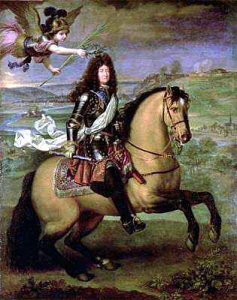
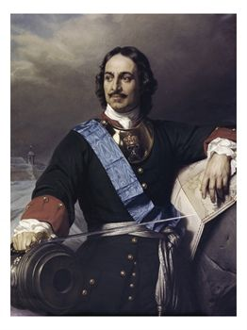
Section 5
ABSOLUTISM in RUSSIA

Slide 2
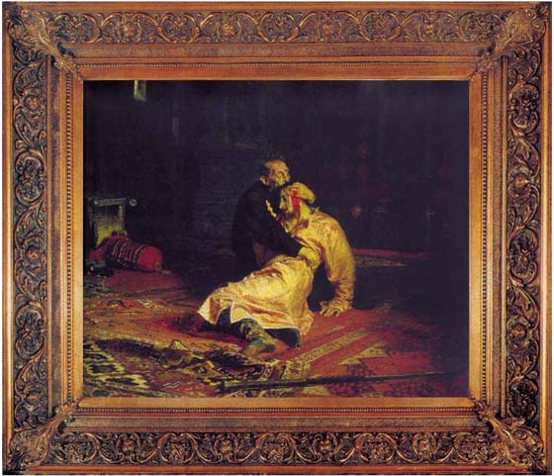
The CZARS The Absolute Monarchs of Russia
Russian rulers broke free of the Mongols in 1480 and built an ABSOLUTE STATE.
The Princes of Moscow took the title of CZAR (Tsar)
Ivan IV, known as “IVAN THE TERRIBLE” consolidated the power of the Czars during the 1500s
He killed many nobles and gave their land away.
Russia went to war to expand its borders

Slide 3
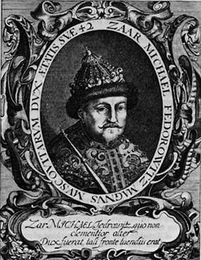
A period of violence followed - called “THE TIME OF TROUBLES”
Nobles vied for POWER
The Time of Troubles ended in 1613 with the election of Michael Romanov as the new tsar.
The Romanov family had been closely associated with Ivan the Terrible whose first wife was related to them. And so he was acceptable as tsar to a people worn out by years of chaos.
Some of the most famous Romanovs include Peter the Great who brought western ways to Russia and Catherine the Great who expanded the Empire

Slide 4
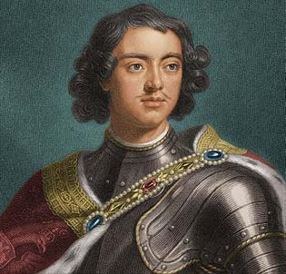
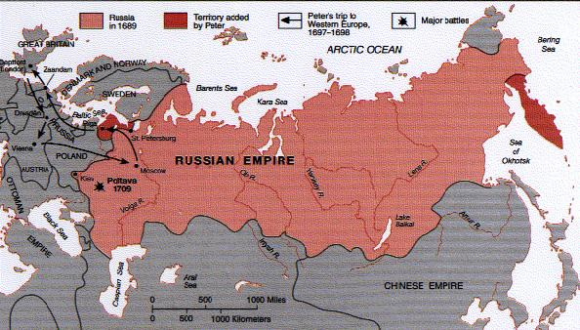
The CZARS The Absolute Monarchs of Russia
1682- PETER THE GREAT inherited the throne
He took control of government in 1689
1697, went to Europe to learn of the “Western Ways” he had heard so much about
Brought back technical experts, teachers, & soldiers from Europe
Through WESTERNIZATION he adopted Western ideas, technology & culture

Slide 5
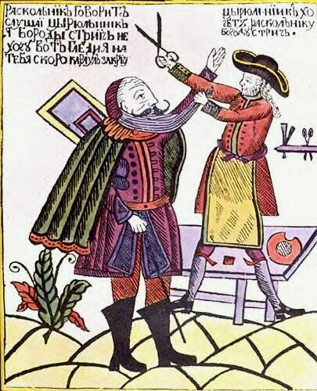
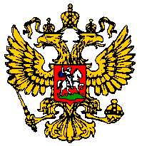
The CZARS The Absolute Monarchs of Russia
Czar Peter used his absolute power to implement a program of westernization in Russia
Beard Laws & Taxes
Introduced European clothes
Let women attend public functions
A Russian cartoon shows Peter the Great personally cutting off the beard of a boyar

Slide 6
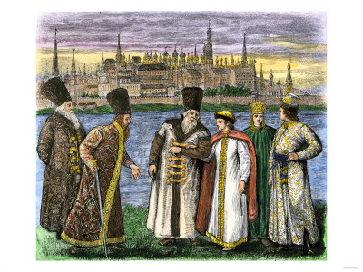
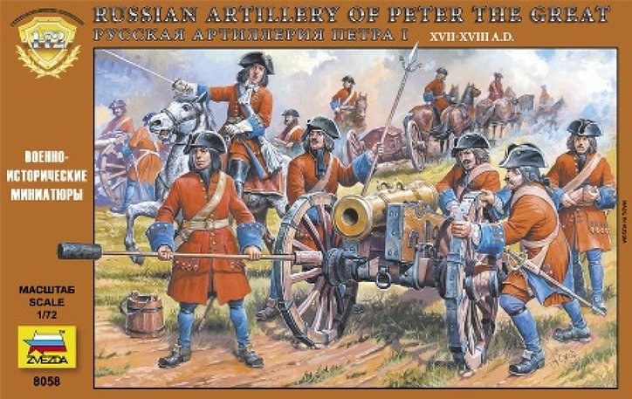
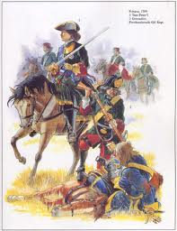
Peter took over all Russian institutions - even the Church
Forced Boyars – landowning Nobles – to serve the State in military positions
He used western military strategies to strengthen his army
Boyars – landowning Nobles

Slide 7
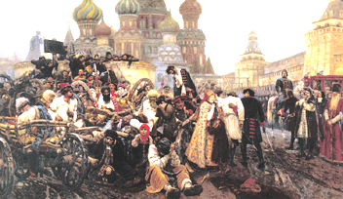
Peter improved:
waterways & canals
Improved education
Simplified Russian alphabet
Set up academies of study
Developed mining & textile manufacturing
Those who revolted were tortured & executed
He left their rotting corpses outside the palace wall for months

Slide 8
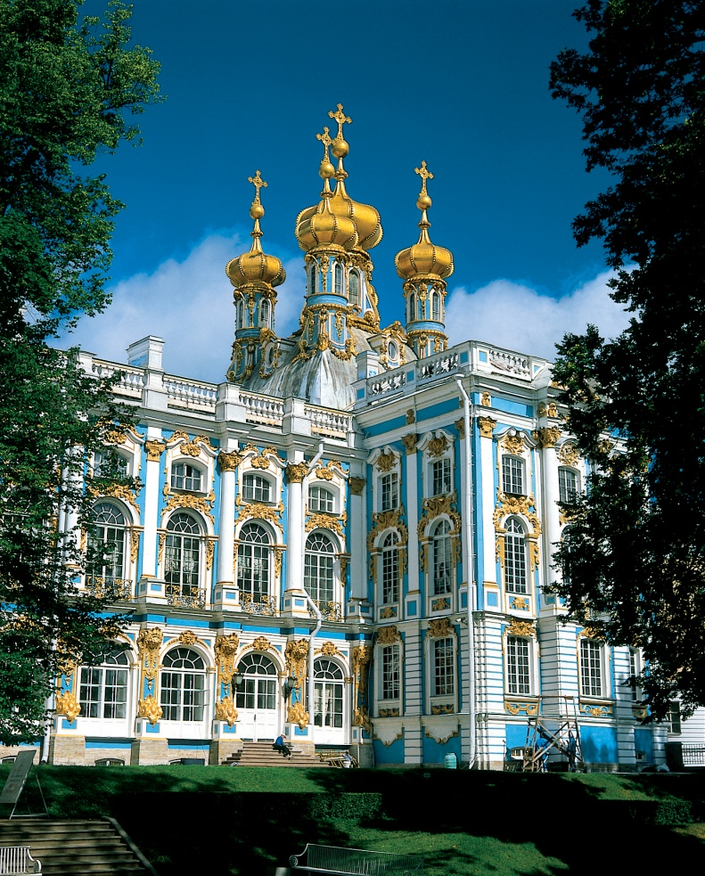
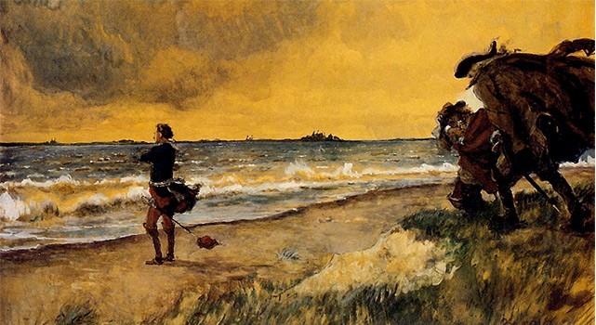
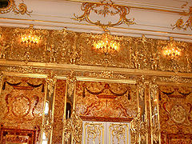
Peter wanted a warm-water port – one that would be free of ice all year
He defeated Sweden in 1709 - victory over Sweden gained the coastline on the Baltic Sea, giving Russia a warm-water port.
Built Palace at St. Petersburg
Peter’s symbol of a modern Europe

Slide 9
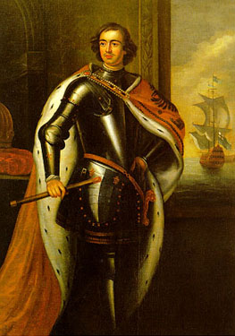
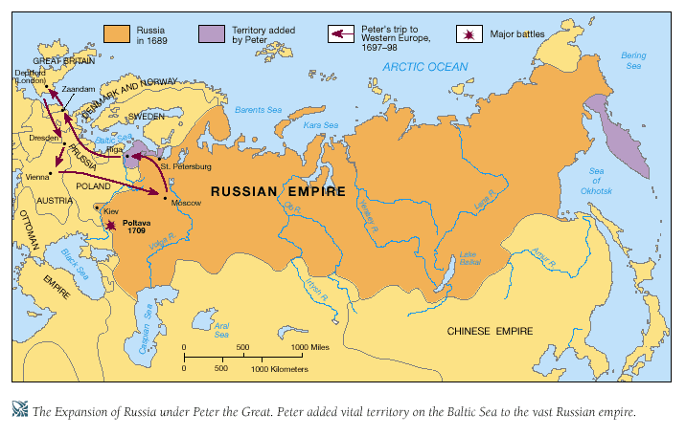
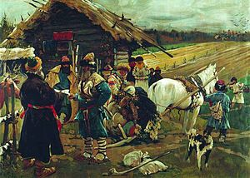
Peter died in 1725 with a mixed legacy:
Ended Russia’s long period of isolation
Many of his reforms died with him
Through use of terror to enforce his absolute power he:
Contributed to the growth of serfdom
Ended up widening the gap between Russia and the west

Slide 10
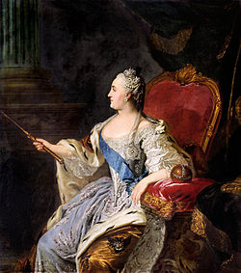
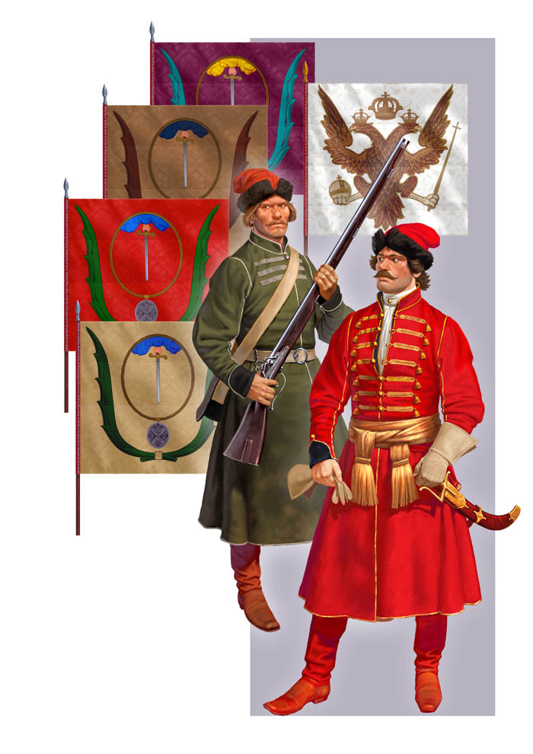
Catherine the Great
A German princess
Came to Russia at 15 to marry Tsar Peter II
Won loyalty of the people
Tsar Peter II was mentally unstable
Russian army officers loyal to her deposed and murdered him
She ascended to throne

Slide 11
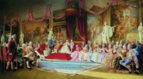
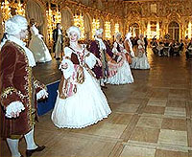
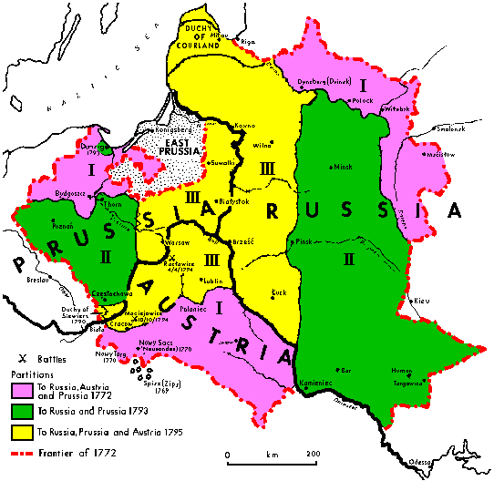
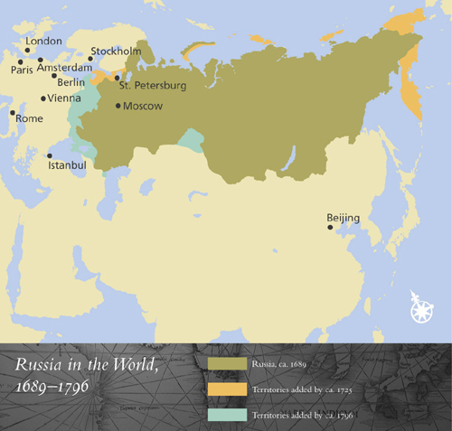
She organized government
Provided education for boys & girls!
Embraced Western ideas
Brought French language & culture to court
Ruthless absolute monarch
Boyars didn’t have to pay taxes
Forced more peasants into serfdom
Expanded Russia’s borders
Russia, Prussia & Austria took over Poland and partitioned it - divided it up amongst themselves

Slide 12
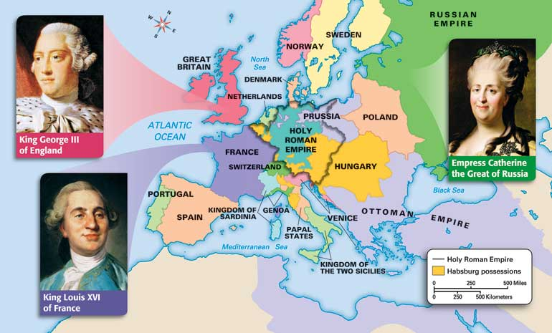
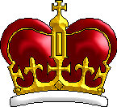
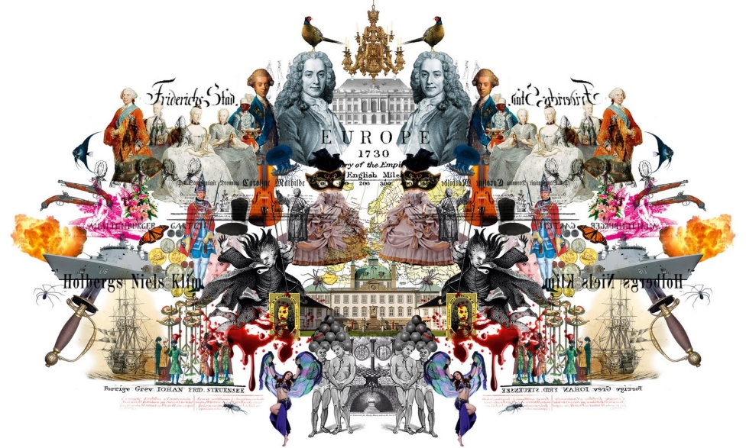
By mid – 1700s absolute monarchs ruled four of the five leading countries
Britain with its strong Parliament was the only exception
Five nations fought to maintain balance of power: Austria. Prussia, Russia, England and France
Radical changes would soon shatter French monarchy, upset the balance of power and revolutionize European societies

